Slide 1
A
SEMINAR
ON THE TOPIC:
GENDER PERCEPTION OF THE EFFECTS OF CLIMATE SMART AGRICULTURAL PRACTICES ON FOOD SECURITY STATUS OF FARMERS IN EKET AGRICULTURAL ZONE, AKWA IBOM STATE, NIGERIA
BY
BLESSING EKWERE
AK18/AGR/AEC/
SUPERVISED BY:
DR. NKEME KESIT
DEPARTMENT OF AGRICULTURAL ECONOMICS & EXTENSION
FACULTY OF AGRICULTURE
AKWA IBOM STATE UNIVERSITY
JULY, 2023

Slide 2
INTRODUCTION
Background of the study
Climate-smart agriculture is an approach to farming that aims at addressing the challenges of climate change while increasing food production and ensuring sustainability and resilience of agricultural systems.
Climate change is described as a change in the average conditions – such as temperature and rainfall in a region over a long period of time (FAO, 2021).
Climate change is a threat to food security systems and one of the biggest challenges in the twenty-first century.
One way of combatting the effects of climate change is through climate-smart agricultural practices (Olaoye et al., 2021).

Slide 3
Background of the study
Despite the multiple benefits of climate-smart agricultural practices and the deliberate efforts by the government and development partners to encourage farmers to invest in them, there is still a lack of evidence on farmers’ incentives, conditioning factors that hinder or accelerate usage and impact of climate-smart agricultural practices on food security status.
Thus, an improved understanding of farmers on climate smart agricultural practices effects in terms of food security is important.

Slide 4
Problem Statement
Some of the farmers have already incorporated the concept of climate smart agriculture, however the adoption still remains low which may be due to limited extension and technical services and knowledge on Climate Smart Agriculture. Most studies concentrated on the influence of climate change to food security but none looked at the agricultural practices that can help in addressing climate change with specific interest on small scale farmers. There is little information on the aspects that influences climate-smart practices to ensure food security in Eket and Akwa Ibom State. Thus, this study will look at addressing the gaps in knowledge in order to understand how Gender as a socio-economic characteristics of farmers affect climate smart agricultural practices effect on food security.

Slide 5
Significance of Study
Benefits agricultural stakeholders; policy makers at all government level, the local farmers, extension officers and Research institutions towards achieving sustainable crop production which in return will improve food security and agricultural productivity.
Objective of the Study
The main objective of the study is to determine gender perception on the effect of the climate smart agricultural practices on food security status of farmers in Eket Agricultural zone, Akwa Ibom State, Nigeria.

Slide 6
The specific objectives are to:
describe the socio-economic characteristic of farming households in the study area
identify the level of awareness and utilization of climate smart agricultural practices in the study area
examine the food security situation in the study area
examine the effects of the climate smart agricultural practices on food security status of farmers in the study area
identify the constraints to climate smart agricultural practices adoption in the study area.

Slide 7
Research Questions
Based on the problems which this research work is aimed at finding solution to the following questions are put forward in finding solutions to the problem;
What is the socio-economic characteristic of farming households in the Eket Agricultural zone?
What is the level of awareness and utilization of farmers on climate smart agricultural practices in Eket Agricultural zone?
What is the food security situation in Eket Agricultural zone?
What are the effects of climate smart agricultural practices on food security status of farmers in Eket Agricultural zone?
What are the constraints to climate smart agricultural practices adoption in the eket Agricultural zone?

Slide 8
Research Hypotheses of the study
H₁: There is no significant relationship between Gender, climate smart Agricultural practices and food security status of farmer in Eket Agricultural Zone, Akwa Ibom State.
H₂: There is a significant relationship between Gender, climate smart Agricultural practices and food security status of farmer in Eket Agricultural Zone, Akwa Ibom State.
Scope of Study
This study concerned with gender perception on the climate smart agricultural practices effect on food security status of farmers will make use of primary data. The primary data will be collected by using a well-structured questionnaire which will be given to the respondents in the study area. It will be divided into sections to reflect the specific objectives of the study.

Slide 9
Conceptual Definition of Terms
Gender: this refers to the male sex or the female sex, especially when considered with reference to social and cultural differences rather than biological.
Perception: this refers to the way in which something is regarded, understood or interpreted
Climate Smart Agricultural practices: According to FAO, Climate Smart Agricultural Practices is described as agricultural practices that are efficient and have a positive long term effect to productivity and revenue generation, mitigates Green House Gases emissions and enhances attainment of national food security as well as sustainable development goals (MFP, 2020).
Food security: Food security is defined when all people, at all times, have physical and economic access to sufficient safe and nutritious food that meets their dietary needs and food preferences for an active and healthy life (FAO, 2019).
Agricultural Zone: these are regions of climate which can reliably grow certain crops which depend on a particular climatic condition to successfully mature and produce.

Slide 10
METHODOLOGY
Study Area and Population
The study will be conducted in Eket agricultural zone of Akwa Ibom State, Nigeria. The main economic activities of the people are farming, trading, fishing from riverine and coastal dwellers and white-collar services. Akwa Ibom State is made up of 31 local government areas (LGAs) with six (6) agricultural zones namely: Uyo, Oron, Ikot Ekpene, Eket, Abak and Etinan. Eket Agricultural Zone consists of five (5) Local Government Area, which are: Eket, Esit Eket, Onna, Ikot Abasi, Mkpat Enin, Ibeno and Eastern Obolo. Eket as the headquarter of the zone is located at latitude 4⁰39’N and longitude 7⁰56’E with a population of over 250,000 in 2019 but updated using 2.50% annual growth rate.

Slide 11
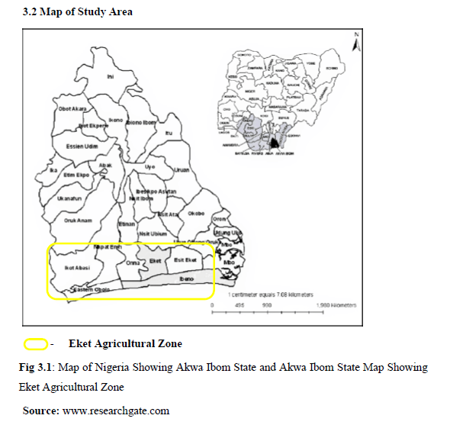

Slide 12
METHODOLOGY
Sampling Procedure
A Two-stage sampling procedure will be deployed in the selection of the respondents. At first stage, simple random sampling (by balloting) will be used to select five (5) blocks (each LGA represent a block) which makes up Eket Agricultural Zone and two (2) cells (villages representing a cell) each of five (5) blocks selected in the zone. The rationale here is to ensure that response of farmers from all the blocks (local Government Area) will be represented.

Slide 13
METHODOLOGY
Method of data collection
The study will make use of primary data. The primary data will be collected by using a well-structured questionnaire which will be given to the respondents. It will be divided into sections to reflect the specific objectives of the study.
Data to be collected will include personal and socioeconomic characteristics such as educational and religious backgrounds, extension contact, years of experience, farm size and membership of cooperatives.
Information will also obtain on agricultural smart practices employed by the farmers, level of awareness and adoption and constraints to the adoption of these practices.
Oral interview involving face to face questioning of the respondents in order to further extract more information or if a farmer cannot read or write will be used to affirm opinion where need arises.

Slide 14
METHODOLOGY
Method of data collection
The level of adoption of climate smart agricultural practices will be established with a 5 –point rating scale of 1- 5 with numerical values of 5, 4, 3, 2, and 1. This will be done to determine the level of adoption practiced by the farmers.
To obtain information on mitigation measures of respondents on climate change effects, twenty-six (26) questions will be presented with a three points likert-type scale of Mostly utilized=3, Utilized=2 and Not utilized=1 and a mean of 2.0 will be used.
Variables with mean scores of 2.0 and above will be adjudged to have severe influence while scores below 2.0 will be adjudged as not severe effect.

Slide 15
METHODOLOGY
Analytical Techniques
Descriptive statistics such as frequency count and percentage will be used to describe socio-economic characteristics of the respondents, sources of information and identification of barriers to farmers.
Likert rating scale will be used to ascertain the level of adoption and utilization of climate-smart agricultural practices.
Food security will be estimated from farmers’ monthly expenditure on food items.
Respondents will be grouped into food security and food insecurity using per capita food security line. Any farmer that will record above 2/3 of mean per capita food expenditure will be grouped as food secured and 2/3 those below will be grouped as food in-secured.

Slide 16
METHODOLOGY
The food security status of farming house will be determine using equation 1
Where, 𝐹𝑖 is the food security index.
If 𝐹𝑖 => 1 household is food secure otherwise if 𝐹𝑖<1, household is food insecure.
There will be 11 items on the scale thus a cumulative score will be obtained.

Slide 17
THANK YOU!!

